Slide 1
PrintNet T
Basic Workflow

Slide 2

PrintNet T Installation
Run the provided PrintNet T installer.
This file has been provided to you along with its installation guide.
Follow the installation guide.

Slide 3
Context Schema
Workflow
Data Input
&
Manipulation
Document
Design
(Layout)‏
Impositioning
Approval (Proof)‏
Spool Production
Notes:
A basic workflow has five elements: Data Input, Data Processing (manipulation), Layout (design), Impositioning, and Output.

Slide 4
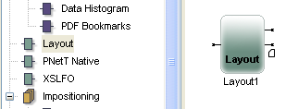
Layout
This module serves for designing documents.
Possible to insert charts, tables, images, or text.
First, drag and drop the Layout module into Workflow area.
Notes:
USE BasicWorkflow.wfd
When the Layout module is opened from the Workflow Area within the Workflow Window, by simply double-clicking on it, the Layout Window is opened. Layout is only one module of a workflow but it is a powerful graphic design centre of its own within PrintNet T.
The Layout Window provides a wide variety of tools to allow you to write, draw, paste, style, position, insert imported data, declare variables, and define relationships between objects.

Slide 5
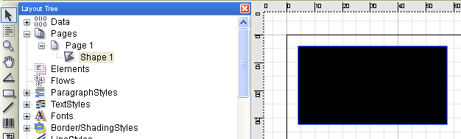
Layout
Access the module by double-clicking on it.
Now we insert a rectangle by clicking on Shape Tool icon and drawing it in the design area.
Notice that this rectangle appears in the Layout Tree as Shape 1

Slide 6
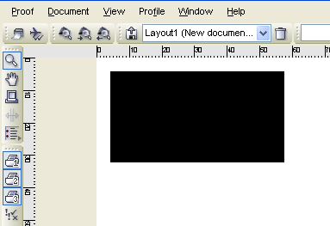
Proof – Displaying a Job
Pressing <F6> in Layout or Workflow shows what the design will look like after leaving a printer.

Slide 7
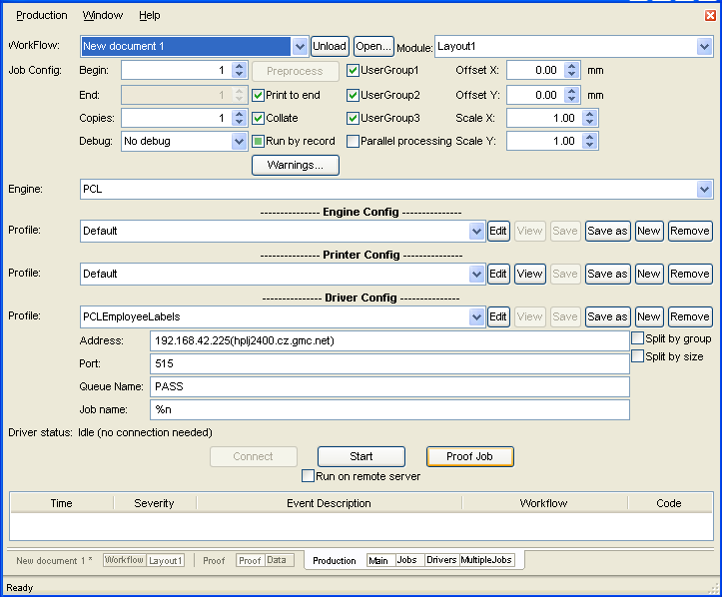
Production – Printing a Job
Pressing <F5> in in Layout or Workflow brings users into the production window.
Clicking the Start button will run the production
Notes:
Pressing <F5> in in Layout or Workflow brings users into the production window, where they can specify the type of printed file or other printing options.
Clicking the Start button will run the production
After the file is printed, show the trainees the printed file in the specified directory.

Slide 8
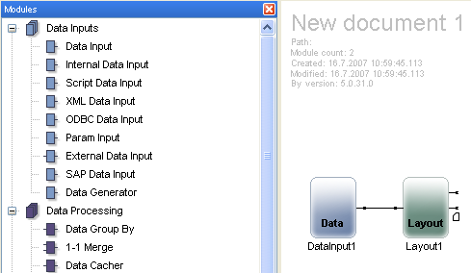
Data Input
Now we will go back into the workflow design and drag and drop a Data Input module.
Connect the modules together by mouse.
Notes:
There are many input modules for different inputs (XML, ODBC, CSV, etc.).
We will use this Data Input module for accessing a data file, e.g., a CSV file.

Slide 9
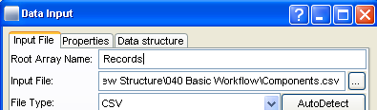
Data Input
Double-clicking on a Data Input module will open a new window.
Users specify Input File and also File Type (in this case a CSV file).
Click OK.
This file is connected to PrintNet T and can be accessed now.

Slide 10
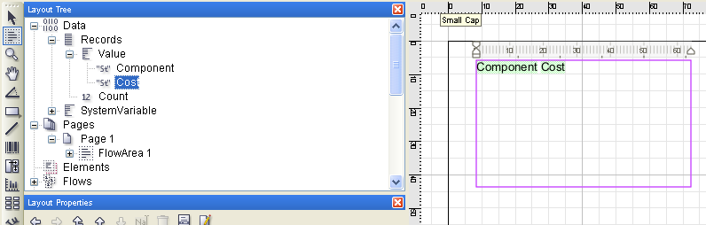
Layout – Using Imported Data
Double-click the Layout module and check the Layout Tree (you can delete Shape 1, which you created earlier).
Notice that it is possible to access the data from the CSV file.
Create a flow area by using Flow Area Tool, and drag and drop both values (variables) into it (by pressing <F6> we can see the result).
Notes:
By accessing the file through the Data Input module, now we can work with its data (in all modules behind this module).
Working in Layout is simple and intuitive, e.g., dragging and dropping variables into a designated area.

Slide 11
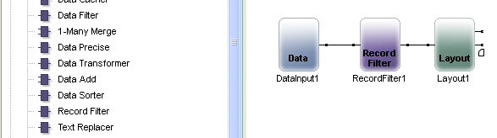
Data Processing
After we have displayed and viewed the data, we return to workflow to add one of the Data Processing modules – Record Filter.
We connect it to the workflow in between the Data Input and Layout modules.
Notes:
Data Processing serves for data modification for further processing.
Data can be converted, filtered, sorted, merged, and much more.

Slide 12
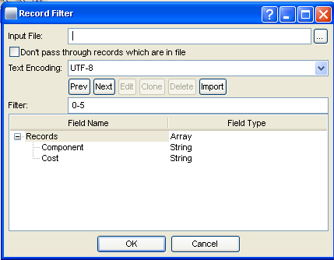
Data Processing
By double-clicking, we access this new module.
We specify the range of records we intend to work with (0 – 5).
Click OK
Notes:
We will switch into Data Proof which shows number of records, etc.
In this case the number of records is 6, because we specified that the filtered records are 0,1,2,3,4,5, (i.e., 6 records – records start with the number 0).

Slide 13
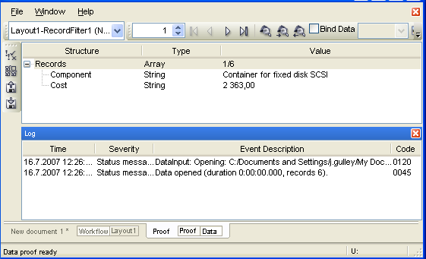
Data Processing – Proof
press <F6> to see the result and switch to Data Proof.
Notes:
We will switch into Data Proof which shows number of records, etc.
In this case the number of records is 6, because we specified that the filtered records are 0,1,2,3,4,5, (i.e., 6 records – records start with the number 0).

Slide 14

Impositioning – Sheet Manipulation
Back in workflow, we can perform some operations regarding our design modifications.
It does not change the design content but includes sheet manipulation.
We drag and drop Transformer and Output modules.
Notes:
Adding Output module serves for terminating the workflow since Impositioning modules can not terminate it.
Note to trainees: if you add an Impositioning module then you MUST also have an Output module before you proof your document (without an Impositioning module, you don’t need an Output module to proof your layout).
Pressing <F6> will proof the job and display what it might look like after being printed.

Slide 15
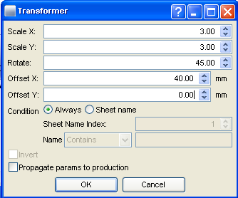
Impositioning – Sheet Manipulation
By double-clicking the Transformer module, we specify rotation, translation, and resizing of sheets.

Slide 16
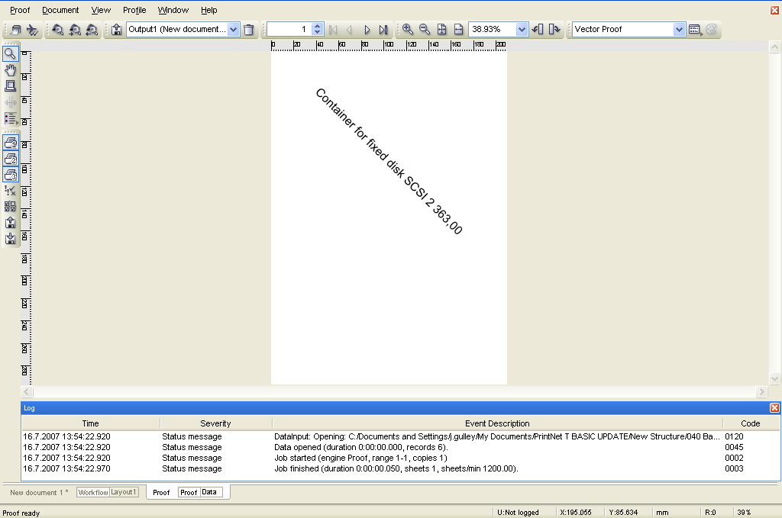
Impositioning – Sheet Manipulation
After all the specified sheet transformations, our proofed design looks like this:
Notes:
Pressing <F6> will proof the job and display what it might look like after being printed.
Finished job is in BasicWorkflow_Done.wfd

Slide 17

Basic Workflow – Discussion
What are the five workflow module types?
How do you proof a job in progress?
How do insert modules into a workflow?
How do you open production?
Notes:
1. What are the five workflow module types?
Data Input, Data Processing, Layout, Impositioning, and Output.
2. How do you proof a job in progress?
Press <F6>
3. How do insert modules into a workflow?
Drag and drop.
4. How do you open production?
Press <F5>

Slide 18

Thank You.
Do You Have Any Questions?

